Slide 1
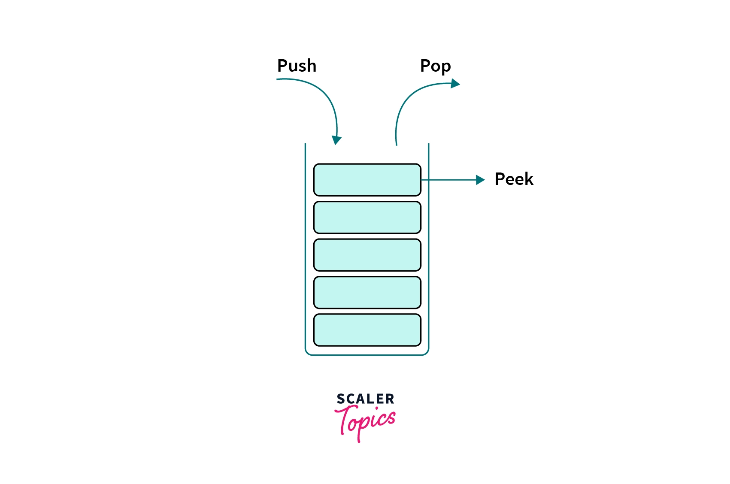
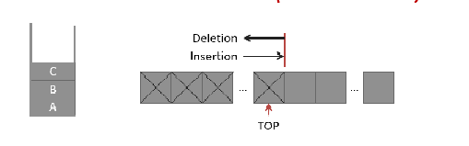
Stack :
The stack is a linear data structure that is used to store the collection of elements by process of insertion & deletion.
In stack insertion procedure is called as push & deletion is called as pop.
Top is a most accessible variable of stack,which point the index of stack.
In stack, procedure of push & pop is perform in order of LIFO(Last-in-First Out).

Slide 2
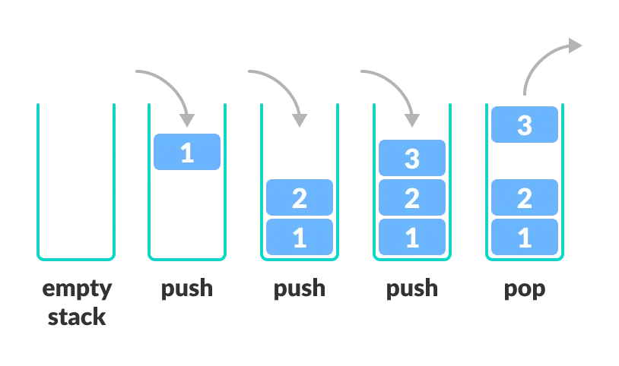
Stack :
Elements :
Top : 0
Top : 1
Top : 2
Top : 3
Top : 2
1
2
3
By Using push, value of Top is Increase by 1 & Using Pop value of Top is decrease by 1 which is show in above figure.
When stack is empty,Top has a value of zero.

Slide 3
Application Of Stack :
Recurison,
Evalution of Expression,
Reversing character,
In undo and redo process,
Recognization process,
Finding Paths,
Expression Conversion
Etc.

Slide 4
Procedure
There are four types of stack procedure.
Push(S,Top,X)
Pop(S,Top)
Peep(S,Top,I)
Change(S,Top,I,X)

Slide 5
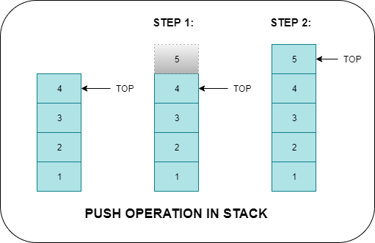
Push(S,Top,X)
Push is used to insert the element in stack.
Here, S is vector of stack , Top is Point Index in stack, X is value of element which we want to insert in stack.
Algorithm:
STEP 1: START
STEP 2 : Store the element to push into array
STEP 3: Check if top== (MAXSIZE-1) then stack is full else goto step 4
STEP 4: Increment top as top = top+1
STEP 5: Add element to the position stk[top]=num
STEP 6: STOP

Slide 6
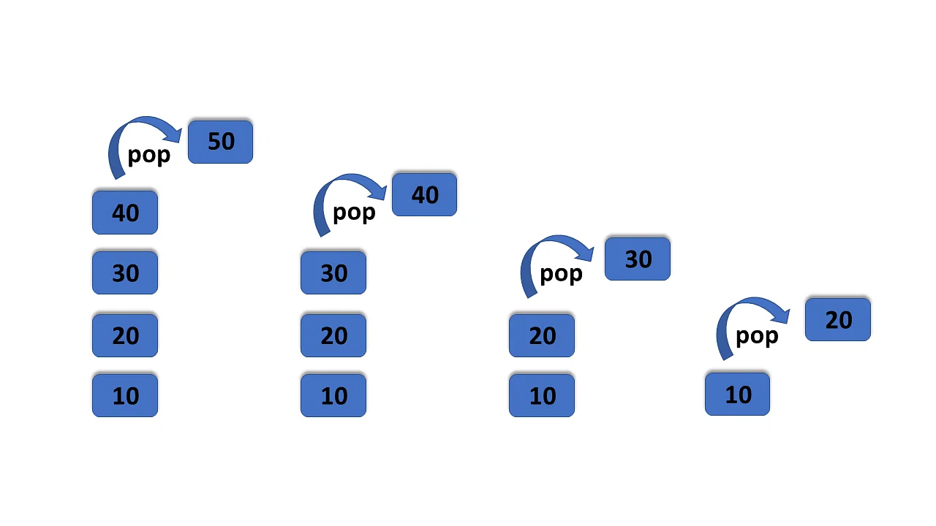
Pop(S,Top)
Pop is used to delete the element in stack.
Here, S is vector of stack , Top is Point Index in stack.
Algorithm:
STEP 1 START
STEP 2 Check if top== (-1) then stack is empty else goto step 4
STEP 3 Access the element top is pointing num = stk[top];
STEP 4 Decrease the top by 1 top = top-1;
STEP 6 STOP

Slide 7
Peep(S,Top,I)
Peep is Display the ith element of the Top Of the stack.
Here, S is vector of stack , Top is Point Index in stack.
Check the stack Overflow condition:-
=> IF Top-I+1 <= 0
Then Write(“statck is overloaded”)
return(0)
2. Return ith element of the top of the stack
=> return(S[Top-I+1])
Top=3, i=2
17
Top = 3
03
i=2
05

Slide 8
Change(S,Top,I,X):-
This procedure change the ith element of the top of the stack to X
Here, S is vector of stack , Top is Point Index in stack,there are N elements in the stack.
Algorithm :-
X=05 ,Top=3, i=2
Check the stack Overflow condition:-
-> IF Top-I+1 <= 0
Then Write(“statck is underflow”)
return(0)
2. Change ith element of the top of the stack
S[Top-I+1] <- X
3. Finished
Return
17
Top = 3
05
03
i=2
05

Slide 9
Recognization:
Recognization is used to check given String belong to following grammer which is show below.
Next is take next element of the String, S is vector of stack , Top is Point Index in stack,there are N elements in the stack.
(i) L={WCW^R}(where W^R is the reverse of W) && (ii) L=a^(i)b^(i)
Algorithm :- (i) WCW^R
1.Initialize stack by placing a letter ‘c’ on the Top
=> Top <- 1
S[Top] <- ‘c’
2.Get and Push symbols until either c’ or blank
is encountered
=> Next <- NextChar(String)
repeat while Next != ‘c’
if Next =‘ ‘
then write(“Invalid String”)
Exit
Else call push(S,Top,Next)
Next <- NextChar(String)
3.Scan characters following ‘c’; compare them to the characters on stack
Repeat While S[Top] != ‘c’
Next <- NextChar(String)
X <- POP(S,Top)
If Next != ‘X’
then write (‘Invalid String’)
Exit
4. Next symbol must be blank
Next <- NextChar(String)
Then write (‘valid string’)
else write (‘Invalid String’)
Exit

Slide 10
Count Recognize:-
Input String
Stack
Input String :
abcba
C
Push=a
a
Ca
Push=b
b
Cab
Pop
Ca
Pop
C

Slide 11
Recurstion :
A Procedure that contains a procedure call to itself.
Recursion is also used to perform with stack.
There are two type of recursion.
Recursion
Primitive Recursion
Non-Primitive Recurison
This is recursive defined function
E.g. Factorial Function
This is recursive use for procedure.
E.g. Factorial Function

Slide 12
Algorithm of Factorial using Stack
Save N and return Address
Call Push(S,Top,X)
2. Is the Base Criterion found?
IF N=0
then Factorial <-1
Go To Step-4
3. Calculate N!
Factorial <- N * Factorial
4. Restore previous N and return address
X <- Pop(S,Top)
Go To Address

Slide 13
Thank You

